Slide 1
Lecture 6 Introduction to Machine Learning ⇨ Speech Processing (including CNNs and templates again)
András Lőrincz
Department of Artificial Intelligence
Faculty of Informatics

Slide 2
Content
Reiteration of networks and convolutional networks
%---------------------------------
Transform speech to fit convolutional networks
Not the only option
Predictive networks
Combinations
Ethical issues
Note: the video of this talk has some problems at the insets, especially at the first inset, the face retargeting example.

Slide 3
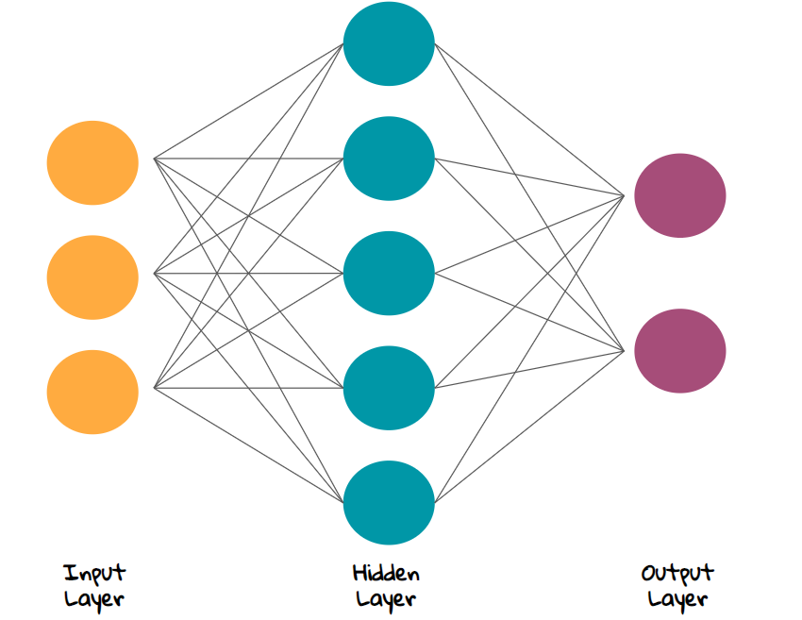
Every line represents a weight. A good picture would show the weight magnitudes by the thicknesses of the lines between the neurons
For each neuron, it is like a dot product between the input vector and the weight vector of that neuron
Neural Networks
Example: shallow network. It is simple and has all components
What is a layer?
a layer is made of neurons (circles)
What can a neuron do?
it receives inputs from previous layers,
transforms its inputs to outputs,
provides the outputs to subsequent layers
What is the transformation?
sums its inputs mulitplied by the weights
applies a non-linear function onto the sum
What are the weights?
they are adjustable numbers that connect the neurons
Drawings are from here:
https://towardsdatascience.com/the-most-intuitive-and-easiest-guide-for-artificial-neural-network-6a3f2bc0eecb

Slide 4
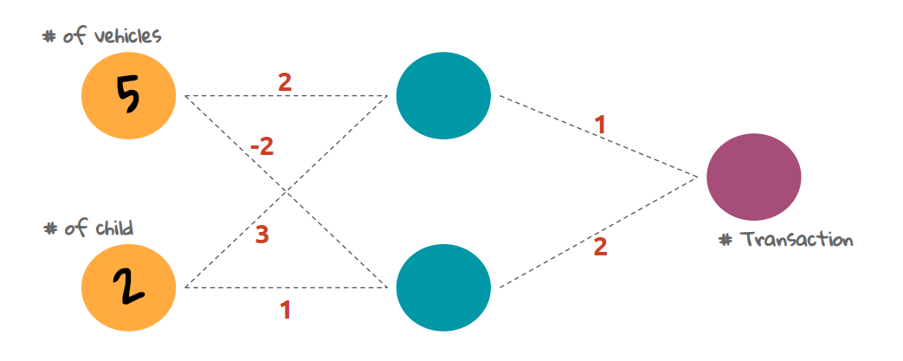
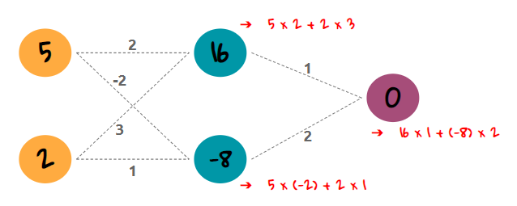
Details without non-linearities

Slide 5
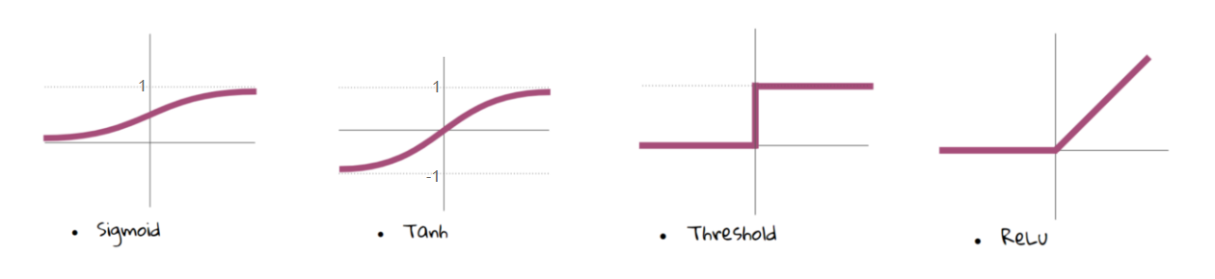
Activation functions

Slide 6
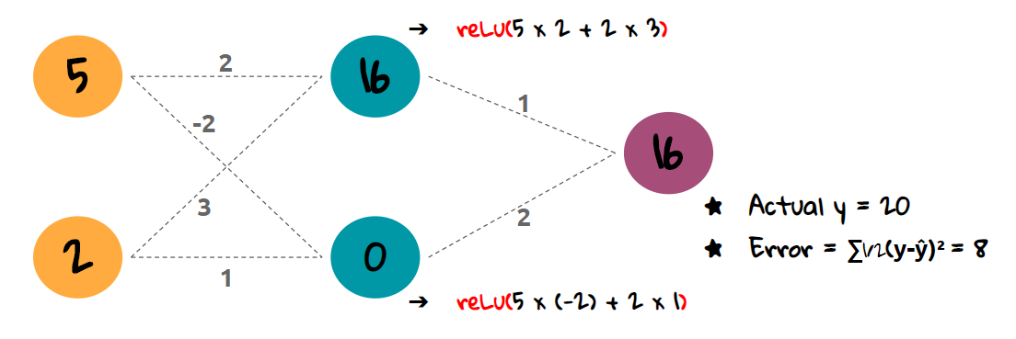
Details with ReLU non-linearities
With ReLU

Slide 7
CNN is an attractive option for large inputs:
➔ now, we have 4 inputs
2
7
7
?? → ReLU!
1
0

Slide 8
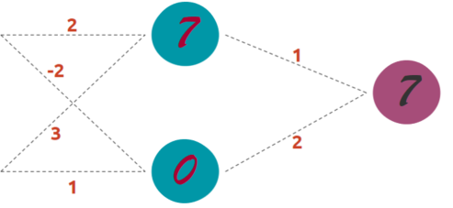
CNN is an attractive option for large inputs:
now, we have 4 inputs
3 similar computations
3 outputs
2
7
7
1
0
17
23
3

Slide 9
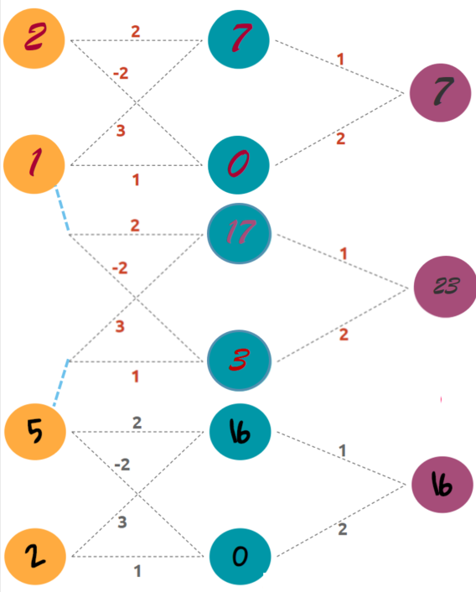
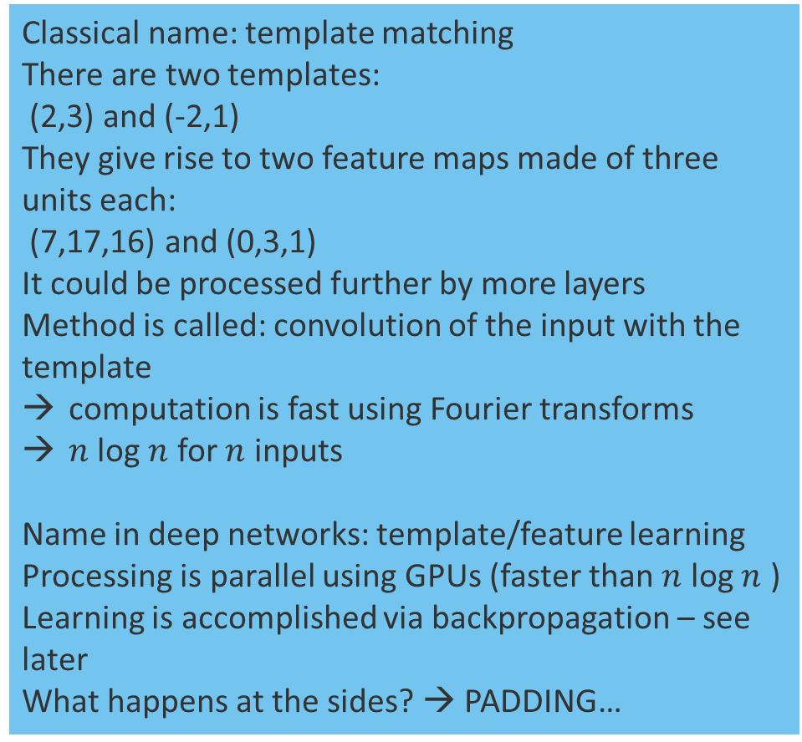
An attractive option for larger inputs:
➔ here 4 inputs
Classical name: template matching
There are two templates:
(2,3) and (-2,1)
They give rise to two feature maps made of three units each:
(7,17,16) and (0,3,1)
It could be processed further by more layers
Method is called: convolution of the input with the template
computation is fast using Fourier transforms
$n$ log $n$ for $n$ inputs
Name in deep networks: template/feature learning
Processing is parallel using GPUs (faster than $n$ log $n$ )
Learning is accomplished via backpropagation – see later
What happens at the sides? → PADDING…

Slide 10
Basic layer of convolutional networks: convolution
Different paddings at the ends:
no padding full padding partial padding full padding
the result: feature maps with different sizes
another variation: stride (step-size) can differ from one

Slide 11
Convolutional Neural Networks (CNNs)
CNNs are made of:
convolutional layers
pooling layers
flattening layer
dense layers
Drawings are from here:
https://towardsdatascience.com/the-most-intuitive-and-easiest-guide-for-artificial-neural-network-6a3f2bc0eecb

Slide 12
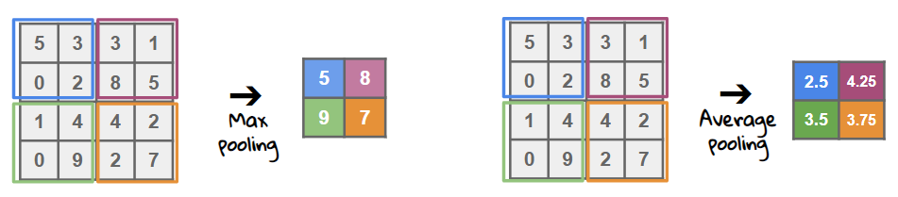
Basic layer: pooling
Stride may differ from one

Slide 13
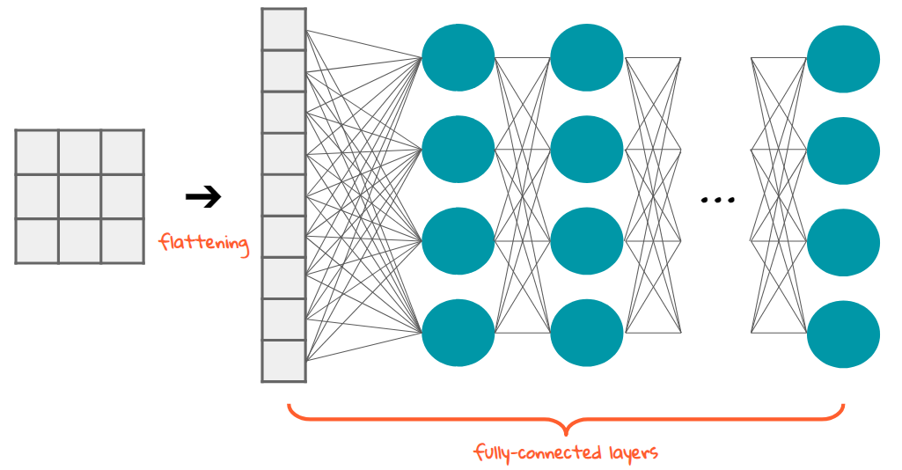
Basic layer: flattening

Slide 14
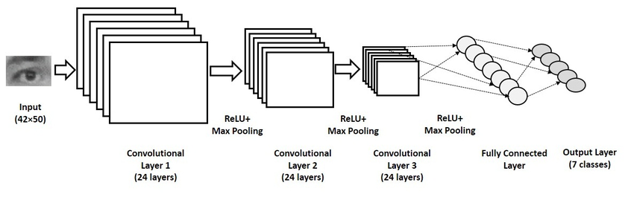
(Simple basic) CNN architecture
Known:
convolutional layer,
ReLU,
Max Pooling,
full connectivity

Slide 15
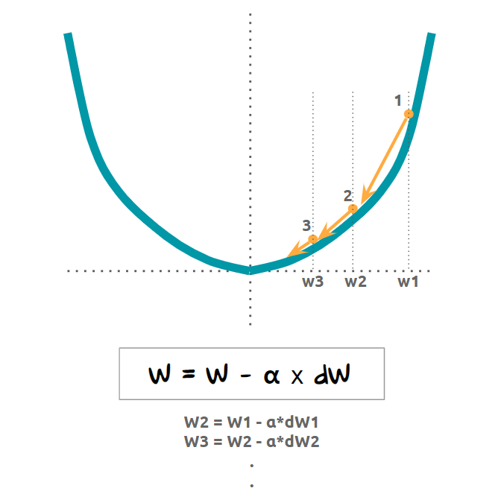
Training
Errors give rise to cost. Cost is decreased by training
Weights are to be modified to decrease the errors

Slide 16
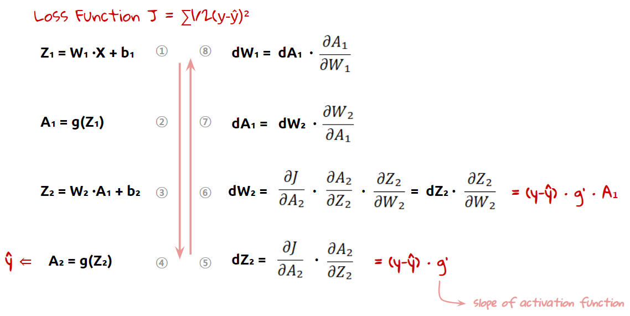
Differentiation: homework for ReLU...
Look up the literature if you want to know the details
Nothing to remember here, if you don’t want to know the details

Slide 17
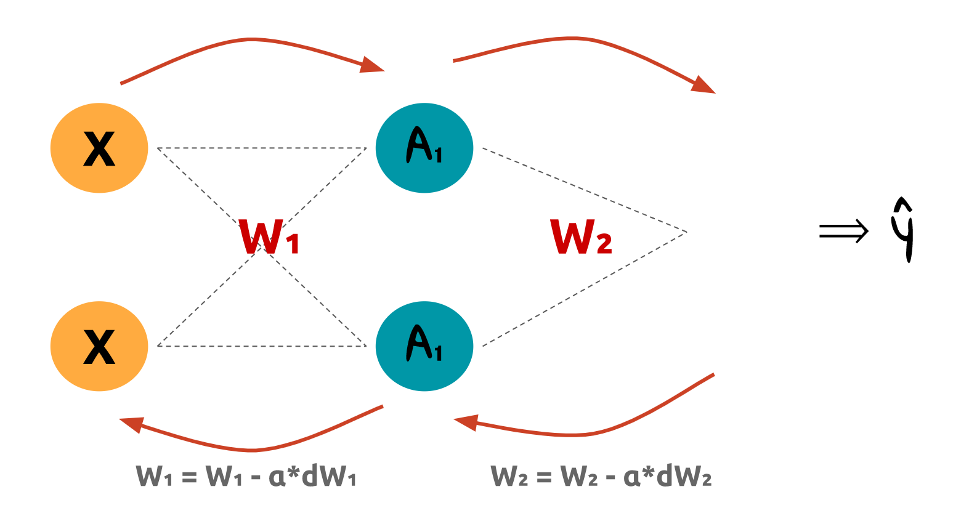
Repeat

Slide 18
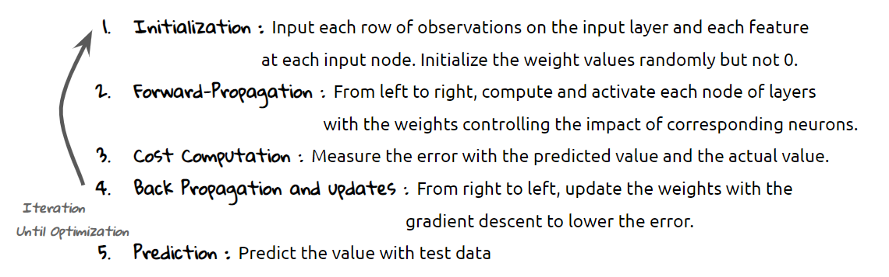
Summary

Slide 19

Rich arsenal of convolutional networks

Slide 20
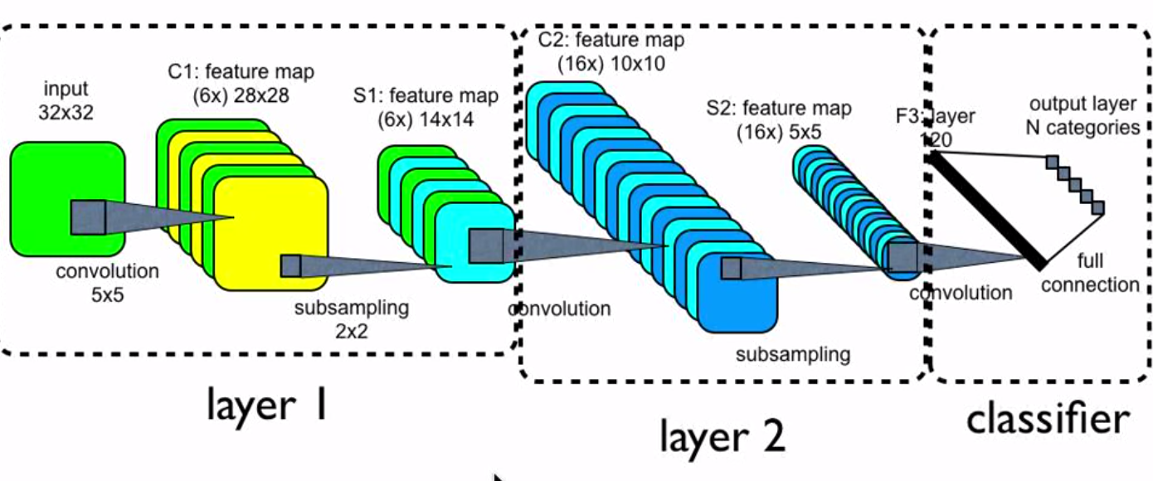
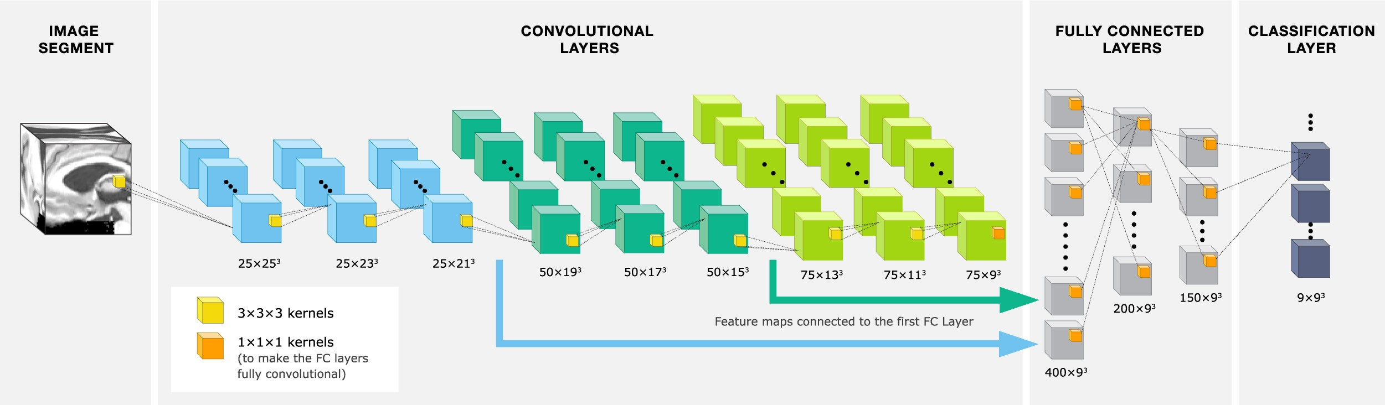
Rich arsenal of convolutional networks
1D convolutions
2D convolutions
3D convolutions
…
https://towardsdatascience.com/understanding-1d-and-3d-convolution-neural-network-keras-9d8f76e29610

Slide 21
We turn to speech Speech can be transformed

Slide 22
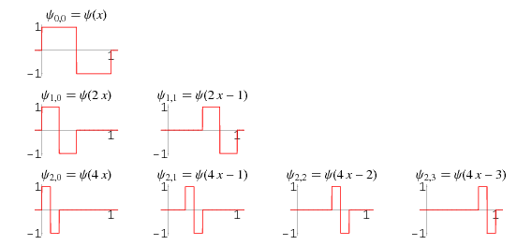
Haar Transform -- intro
http://mathworld.wolfram.com/HaarFunction.html

Slide 23
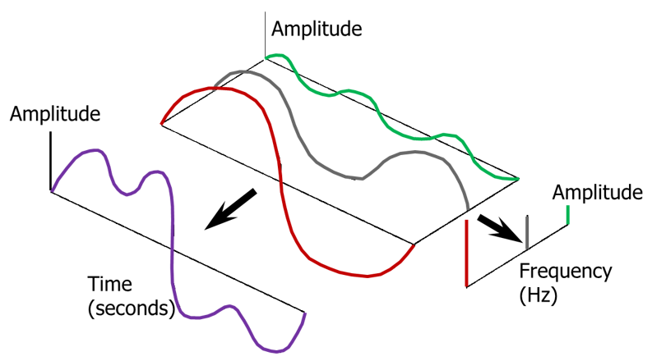
Fourier transform
https://community.sw.siemens.com/s/article/what-is-the-fourier-transform

Slide 24
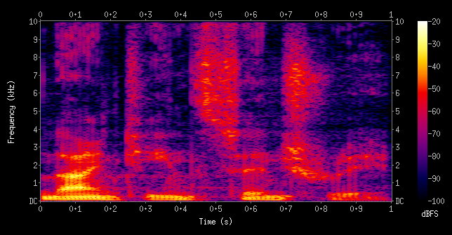
Spectogram
Spectrogram of the spoken words
"nineteenth century".
Frequencies are shown
increasing up the vertical axis,
and time on the horizontal axis.
The legend to the right shows
that the color intensity increases
with the density
A spectrogram is a visual representation of the spectrum of frequencies of a signal as it varies with time.
It shows the magnitudes of the frequencies of short term Fourier transforms: i.e., it shows the magnitudes of the Fourier components in short time intervals
https://en.wikipedia.org/wiki/Spectrogram
https://www.slideshare.net/karpnv/speech-signal-time-frequency-representation

Slide 25

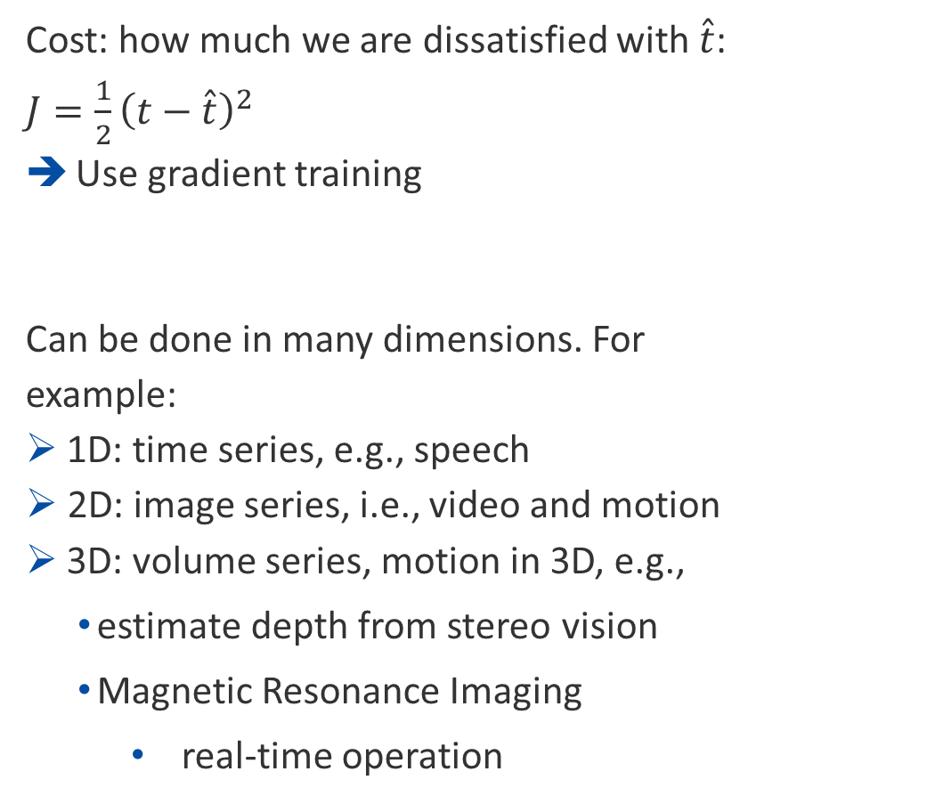
$\hat{t}$
Prediction
Cost: how much we are dissatisfied with $\hat{t}$: $J=\frac{1}{2}{\left(t−\hat{t}\right)}^{2}$
Use gradient training
Can be done in many dimensions. For example:
1D: time series, e.g., speech
2D: image series, i.e., video and motion
3D: volume series, motion in 3D, e.g.,
estimate depth from stereo vision
Magnetic Resonance Imaging
real-time operation
t-1
t-2
t-3
t-4
Homework: draw, how to do the same on
the hidden representation of an autoencoder
„How to predict the next hidden representation?”
Blue lines
represent a dense network
it could be deep

Slide 26
Retargeting is possible both in image and in speech. Here, it is image only
„A Deeper Look Into The Life of An Impressionist by Jim Meskimen”
https://www.youtube.com/watch?v=5rPKeUXjEvE

Slide 27
Technology misuse is possible
Generation of
fake speech
fake face and fake body
synchronization of speech and lip motion (link)
fake background → see Skype, Zoom, and so on for real time processing
All of these components have been improving to high quality
https://www.businessinsider.com/james-dean-posthumous-casting-in-new-movie-through-visual-effects-2019-11
64 years after James Dean's death, the actor will star in a new movie. Some in Hollywood are horrified but the advances in visual effects could make it commonplace.

Slide 28
Ethical concerns
https://www.youtube.com/watch?v=pg5WtBjox-Y

Slide 29
Thank you
for your
attention!
lorincz@inf.elte.hu

Slide 30
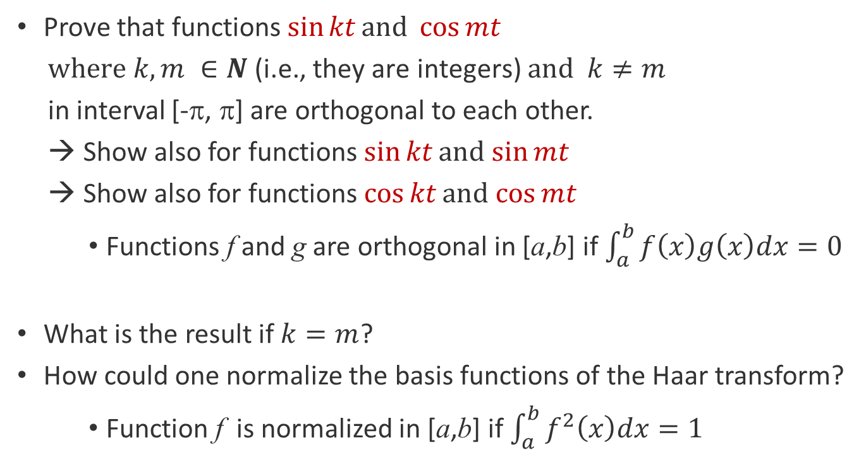
Homeworks
Prove that functions $\sin{kt}\text{and} \cos{mt}$
$where k,m ∈N \text{(}\text{i}\text{.}\text{e}\text{., }\text{they} \text{are} \text{integers}\text{) }\text{and} k≠m$
in interval [-π, π] are orthogonal to each other.
Show also for functions $\sin{kt}\text{and}$ $\sin{mt}$
Show also for functions $\cos{kt}\text{and}$ $\cos{mt}$
Functions f and g are orthogonal in [a,b] if $\int_{a}^{b}{f\left(x\right)g\left(x\right)dx=0}$
What is the result if $k=m$?
How could one normalize the basis functions of the Haar transform?
Function f is normalized in [a,b] if $\int_{a}^{b}{f^{2}\left(x\right)dx=1}$

Slide 31
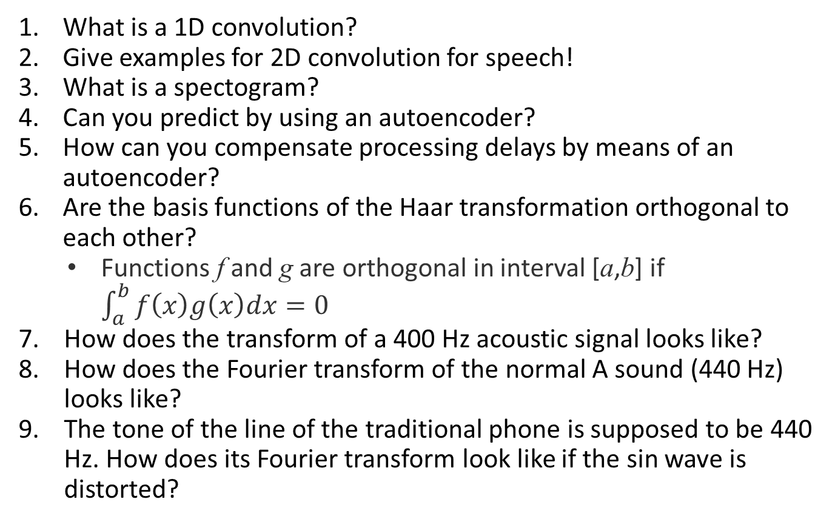
Some issues that you may be asked about
Expect similar ones in the exam…
What is a 1D convolution?
Give examples for 2D convolution for speech!
What is a spectogram?
Can you predict by using an autoencoder?
How can you compensate processing delays by means of an autoencoder?
Are the basis functions of the Haar transformation orthogonal to each other?
Functions f and g are orthogonal in interval [a,b] if $\int_{a}^{b}{f\left(x\right)g\left(x\right)dx=0}$
How does the transform of a 400 Hz acoustic signal looks like?
How does the Fourier transform of the normal A sound (440 Hz) looks like?
The tone of the line of the traditional phone is supposed to be 440 Hz. How does its Fourier transform look like if the sin wave is distorted?

